Slide 1
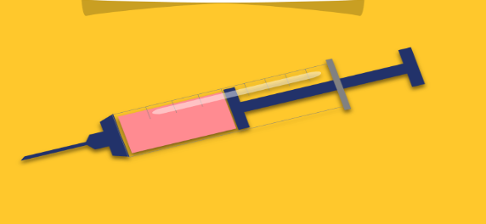
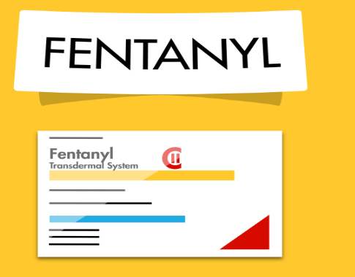
sddec19-07 • Rapid detection of Fentanyl using a multifunction nanostructured substrate
Team Member: Yifu Zhang , Zheyuan Tang , Hao Wang , Ugerah Abalu , Kossi Egla , Olouwole Eteka
Team Email & Website: sddec1907@Iatate.edu http://sddec19-07.sd.ece.iastate.edu/
Advisor: Dr. Meng Lu
Client: Dr. Meng Lu
Senior Design Group 7: Technique of detecting Fentanyl

Slide 2
Problem statement:
The purpose of this research project is to design a system that can detect fentanyl in a mixture of chemicals by separating compounds. The system will use “thin layer chromatography” to separate the compounds using a 3D printed optical instrument that detects the existence of fentanyl
General Solution Approach: The project is split into three smaller design tasks.
The first task is to fabricate the chromatography paper and the GLAD(Glancing angle deposition) film. The task will be accomplished as follows:
a) Research the appropriate material and solvent for mobile phase and stationary phase, to separate the fentanyl out from component obviously.
b) Use glancing angle deposition to fabricate the ultra thin layer plate by electron beam.
The second task is to test the chromatography based on paper and film created on the first task.
c) Test the chromatography on GLAD film
d) Test the chromatography on PC-GLAD
The third task is to test the entire instrumentation system
e) Test the system of instrumentation (data analysis)

Slide 3
Semester Deliverables
First semester Deliverables: Our client requirements and expectations for the 1st semester were as follows:
1.) Carry out a simple chromatography experiment
2.) Test dye separation on chromatography paper
3.) Fabrication of GLAD film
4.) Fabrication of Photonic crystal
5.) Test Chromatography on GLAD film

Slide 4
Semester Deliverables(CONT.)
Second Semester Deliverables:
Our client requirements and expectations changed this semester. Our main tasks were as follows:
1.) Instrumentation: Optical detection setup. It consists of the entire setup system for running the proposed experiment with a light source
2.) Nanoporous sensor fabrication: GLAD coating of a PC substrate(360 nm period) This was a major deliverable for us as is the fabrication of the actual sensor that would be used in the next phase of the project to separate mixtures containing fentanyl
3.) Chromatography sensor test: Have a good capillary flow rate We were able to have a good flow rate on the fabricated Silicon dioxide photonic sensor on which the dye was spotted. To ensure this, we also used the BOE etching process to increase the porosity of the sensor and aid liquid flow

Slide 5
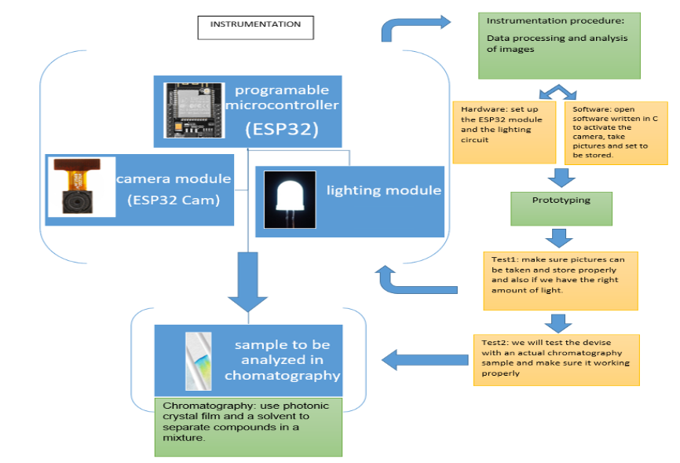
Design Diagram:

Slide 6
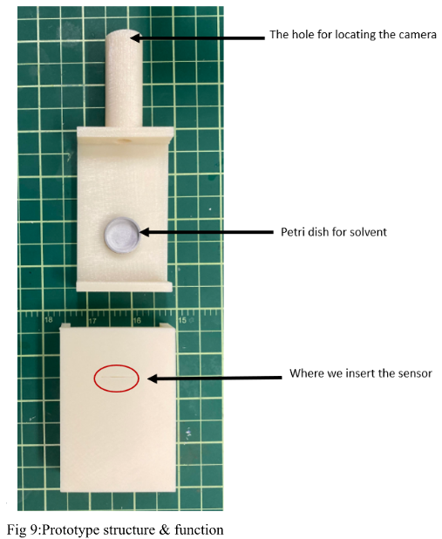
Working principle:
The lens of the camera is connected from the tube on the device
There is a cut on the bottom that hold the petri dish with solvent inside
There is a cut on the cover that aligns with the petri dish to allow the sensor to slide into the solvent
The camera will be taking pictures while the separation is going on and store them on a computer through WiFi

Slide 7
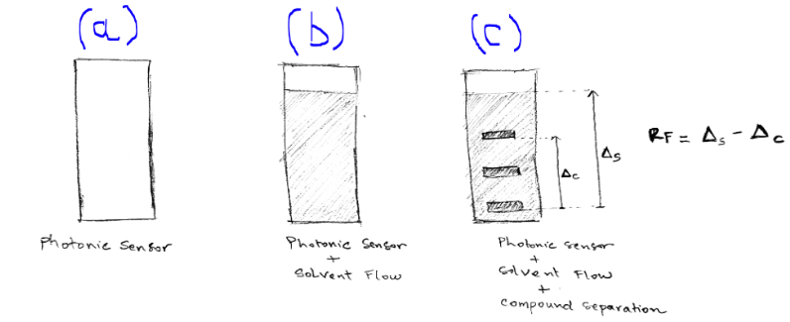
Working principle (CONT.):
IN IDEAL CONDITIONS
Take pictures
Calculate retention factors of the compounds inside the mixture
Make a decision if the mixture contains fentanyl by comparison of RF values.

Slide 8
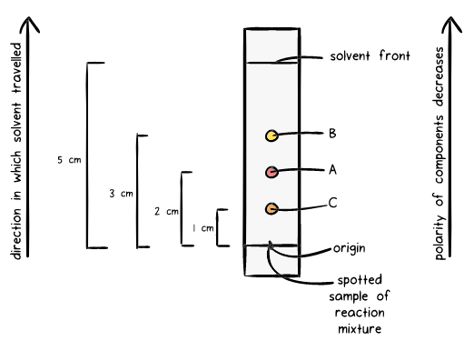
Chromatography

Slide 9
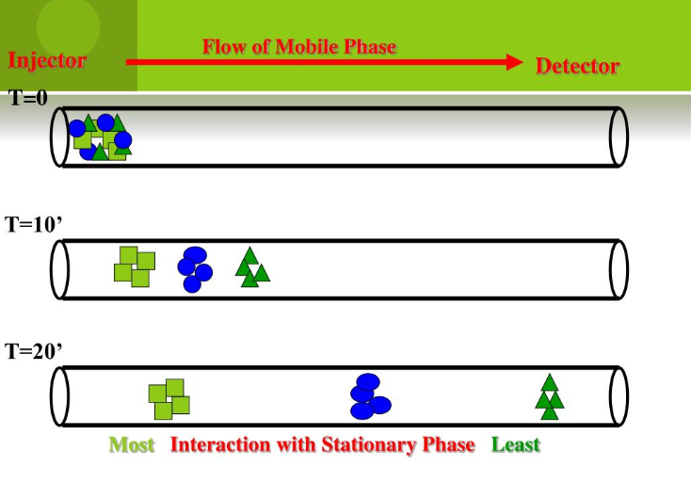
Separation
Mobile phase Interaction with stationary phase
Successful separation!

Slide 10
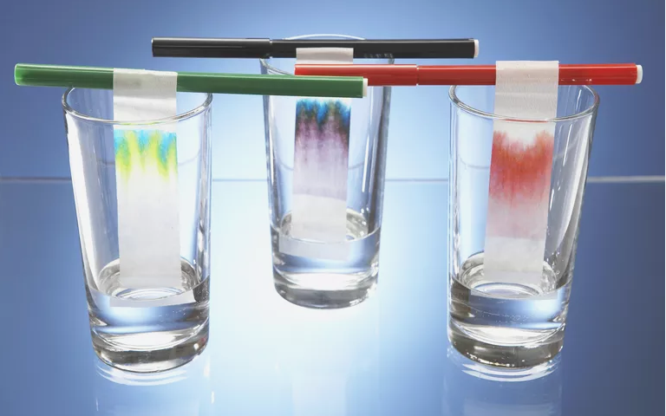
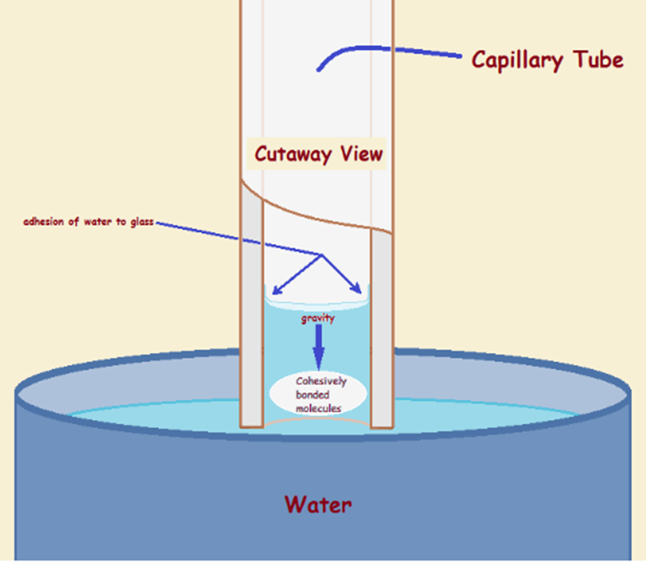
Capillary force

Slide 11
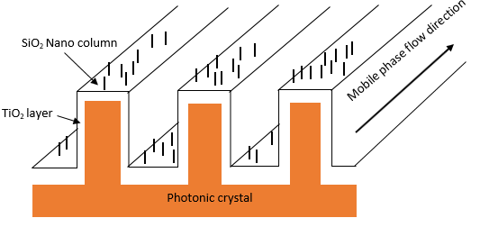
Fabrication of photonic sensor
structure of photonic sensor

Slide 12
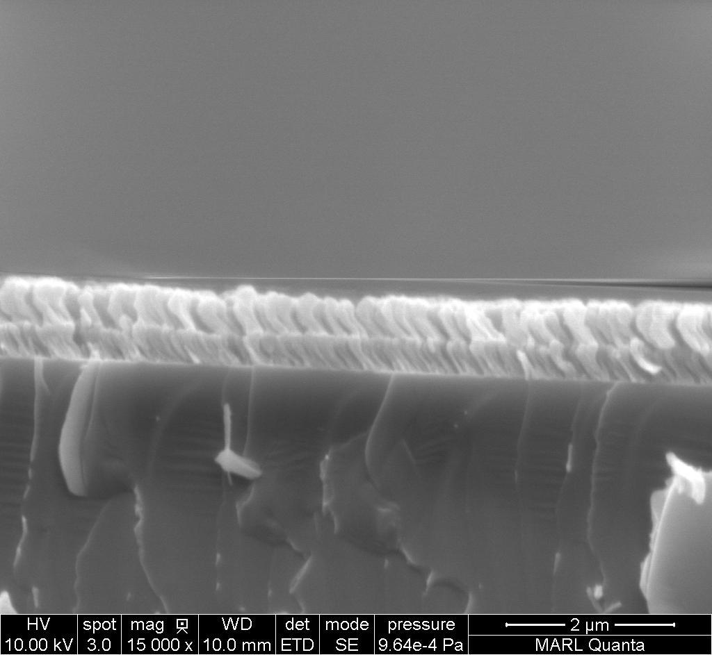
SEM of the SiO2 column

Slide 13
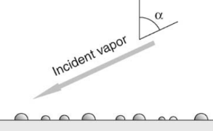
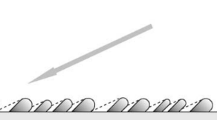
Glancing Angle Deposition
Electron beam evaporation

Slide 14
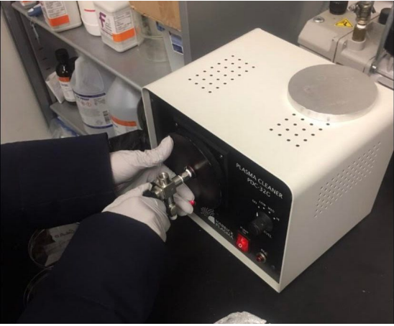
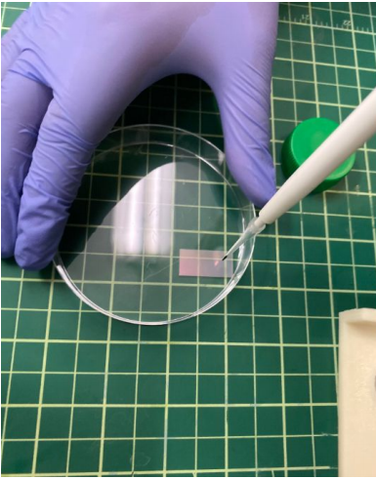
Design process
Oxygen plasma machine
Testing of the sensor
Oxygen plasma
Improve the hydrophilic property of the photonic sensor
Dip the dye on the sensor
Details: Use the packpad tube to soak the mixed dye
(The position of dye should not be lower than the surface of the solvent)
Attention: The dye should not to be too much on the sensor

Slide 15
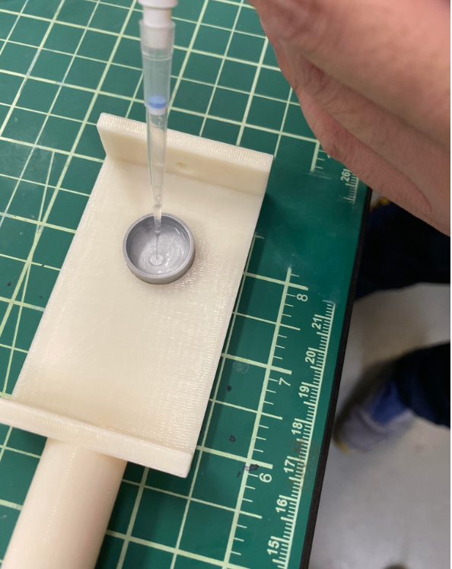
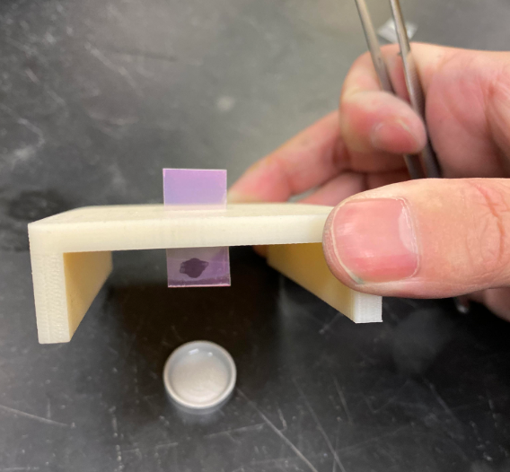
2. Put the sensor into a cleaned container
Details:
(1) Use the needle to soak some of the solvent and push it into a cleaned metal container (Aluminum petri).
(1) Use the tweezers to hold the corner of photonic sensor, carefully put it into the container, the backside of the sensor should be faced to the container dege.
Attention: The dye should be totally dried before putting the sensor into container

Slide 16
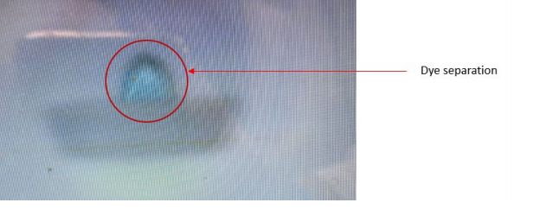
3. Observe the result and give the feedback
Details:
The separate process will take about half hour, we can observe the result directly from the sensor after the separating process is done.
We are expect to see the different colors of the dye for improving the separate process is successful.
Attention: Don’t touch the sensor by fingers during the experiment

Slide 17
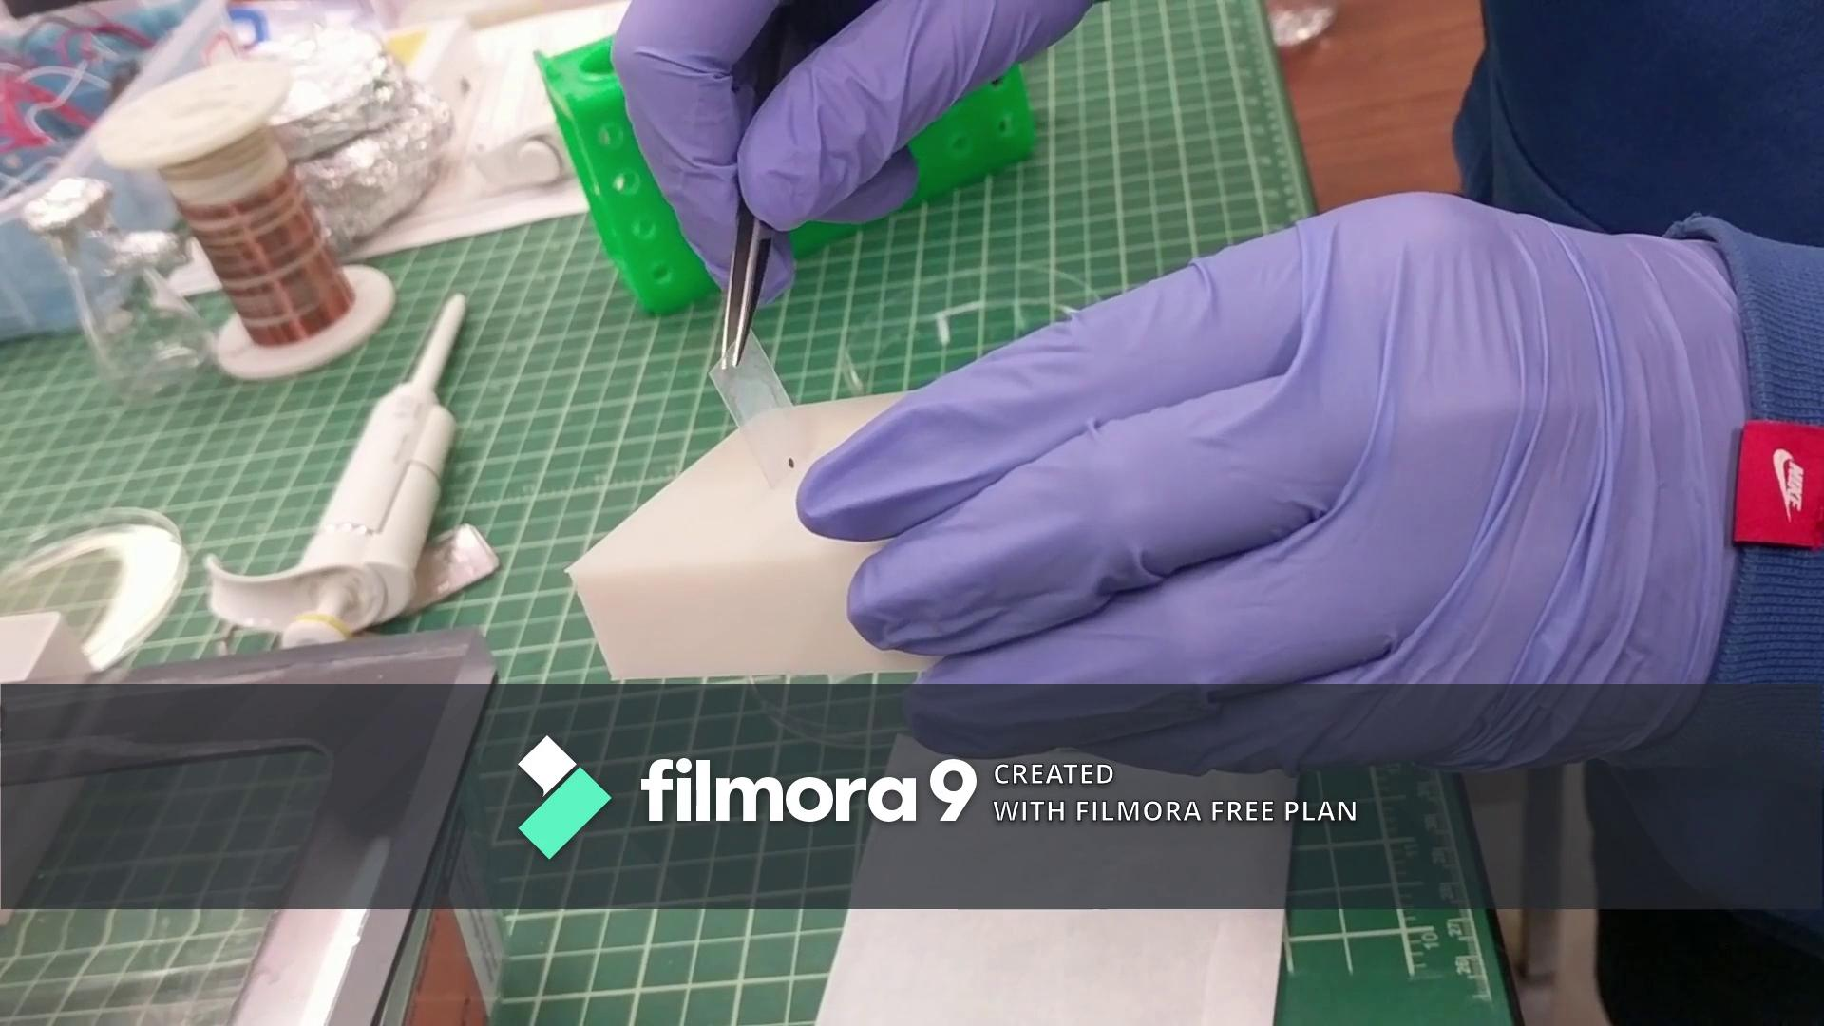
Design process
Principle of Chromatography and experiments using dye

Slide 18
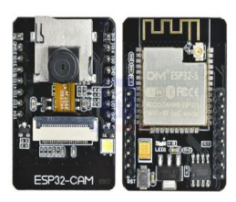
Design process
ESP32-CAM
The ESP32 camera is a small and cheap camera module that cost around $9.
It has 2Mp resolution camera, wifi capability, 520kB built-in SRAM and SD card slot to store data onboard.

Slide 19
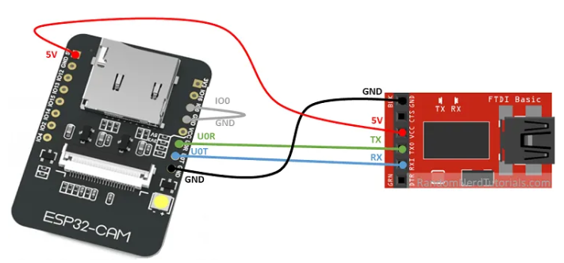
Design process
Programing the ESP32-CAM using FTDI programmer
FTDI is the device we used to program the ESP32-CAM
It has 4 output: the ground, 5v power supply, TX abd RX

Slide 20
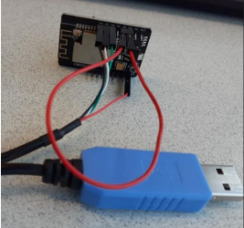
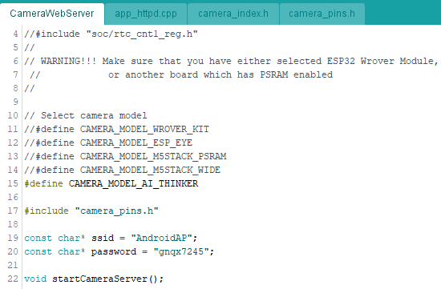
Design process
How is the ESP32-CAM works?
Connect the ESP32 to computer via the FTDI, and upload the code provided by the manufacturer from arduino IDE.
The ESP32 should be connected to the same network of the device it should stream data into.

Slide 21
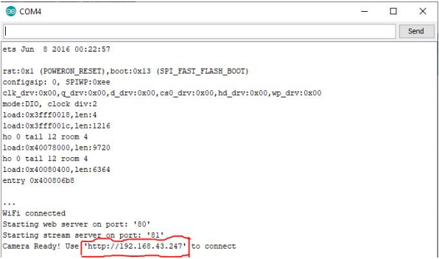
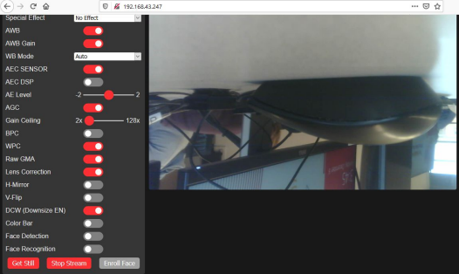
Design process
Get IP address from the IDE serial monitor and type it into a browser to start streaming data.

Slide 22
Conclusion and Future works
Our main conclusion from this phase of the project is that the fabricated silicon dioxide photonic sensor is a suitable sensor for separating mixtures. From our various experiments using dye in place of fentanyl, we were able to get consistent liquid flow up the sensor and separation of the dye.
The next phase of this project will involve the main testing stage of experimenting with fentanyl mixtures on the photonic sensor to see if there is good liquid flow and separation can me made. In this phase, we were able to use a dye as a substitute to separate on a fabricated silicon dioxide substrate photonic sensor and see liquid flow.

Slide 23
Thanks for your attention

